Slide 1







EagleSat 2
Becca Laub – Project Manager
Embry-Riddle Aeronautical University
Arizona Space Grant Consortium Symposium
April 13th, 2019

Slide 2
Outline
Project Overview
Requirements
CDR
Design
Interface Control Document (ICD)

Slide 3
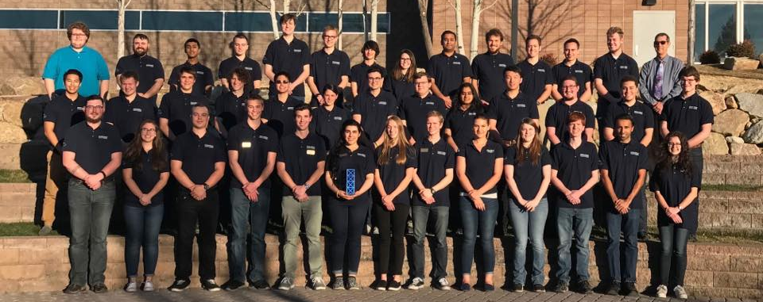
Purpose and Benefits
Education
Strong, achievable scientific goals
Commercially available bus systems
Work with teams, departments, and organizations both on and off campus

Slide 4
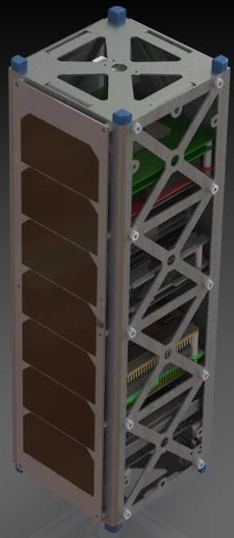
Mission Overview
Scientific Goals
  Memory degradation experiment (MDE)
  Cosmic Ray Payload (CRP)
Spacecraft – 3U CubeSat
SELECTED - 2018 NASA CubeSat Launch Initiative
Designing for ISS orbit
  402-424 km
  51.6 degree inclination

Slide 5
Requirements
Three levels
  Program
  System
  Subsystem
Written fall 2018
Workspace Requirements Management Tool

Slide 6
Critical Design Review (CDR)
November 19th, 2018
~400 slide package presented to industry professionals, venders, and professors
Finalized design

Slide 7
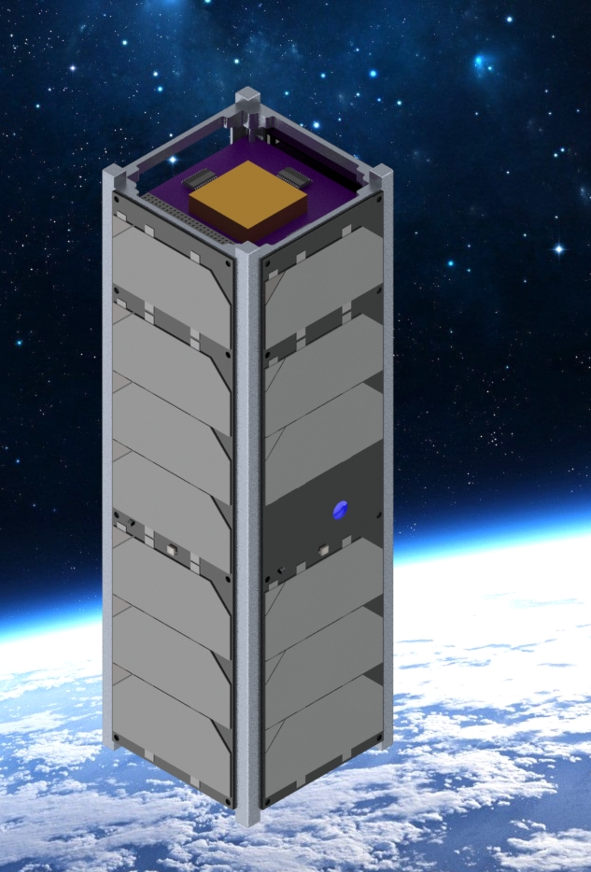
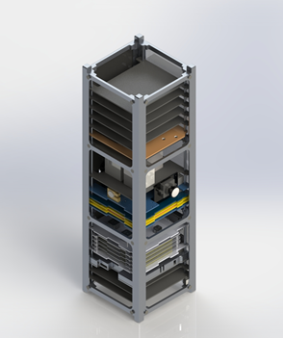
Current Configuration

Slide 8
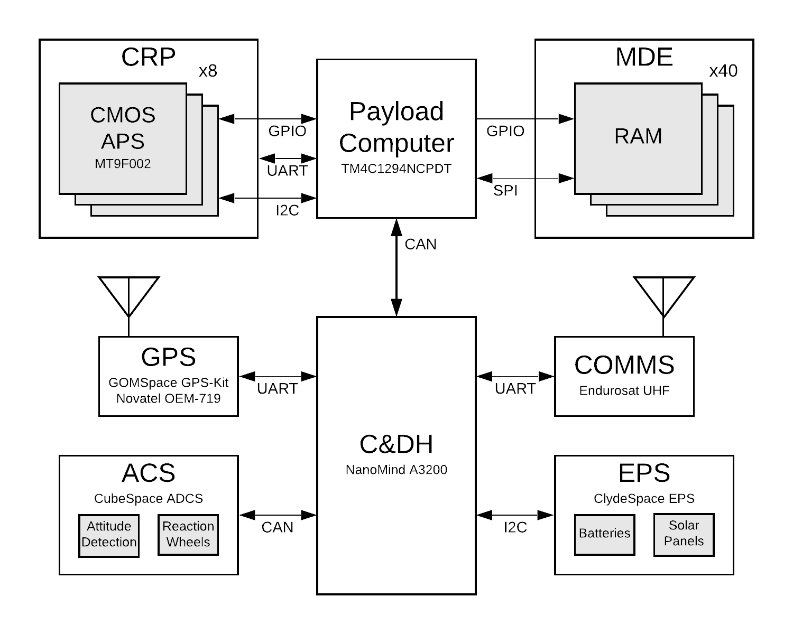
System Architecture Overview

Slide 9
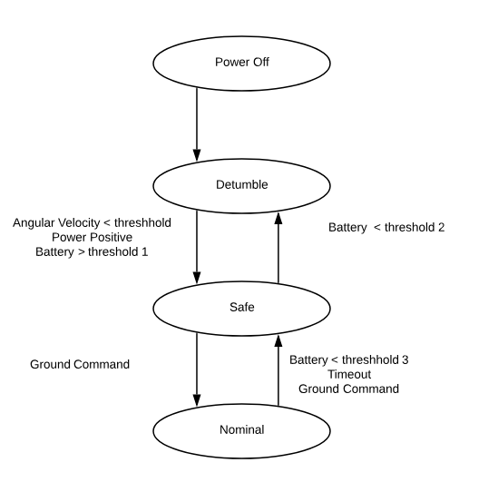
Modes of Operation
ACS | EPS | Comms | OBC | Payloads
Magnetorquer | Generating Power | Off | Boot up, assist detumble, monitor state | Off
Magnetorquer | Generating power | On | Listen for ground commands | Off
Reaction wheels and magnetorquer | Generating power | Rx and Tx | All functionality | On

Slide 10
Current task – Interface Control Document
Subsystem level ICDs
Capture design of subsystem and how it affects other subsystems
Ensure design has no conflicts
High traffic interfaces have separate ICDs
  OBC Payload Computer to OBC bus computer
Combined to make whole system ICD

Slide 11
EagleSat 2
Questions?

